Slide 1

Healthcare Analysis (Excel Version)
Natalie Ramdeo

Slide 2
Introduction
This presentation will go over the results of the Healthcare dataset. Specifically, comparing males and females through various things like medical condition and blood type.

Slide 3
Purpose of this Analysis
The purpose of this analysis is to have a condensed version where it focuses on specific areas of the dataset.
During my first analysis using Python, I covered all parts of the dataset, so the Excel version will be a simplified version.
There are 3 main purposes of this analysis. The first one is to see what medical conditions affects each gender and by how much. The other is to see what which blood type each gender has and by what margin. The third and final purpose is to see what type of insurance providers each gender chooses.

Slide 4
What will be analyzed?
We will compare genders to various circumstances like Medical Conditions, Blood Type, Test Results, and Insurance Provider.
We will see what type of medical conditions males and females have along with their blood types. We will also see what their test results were and what Insurance Provider they have.

Slide 5
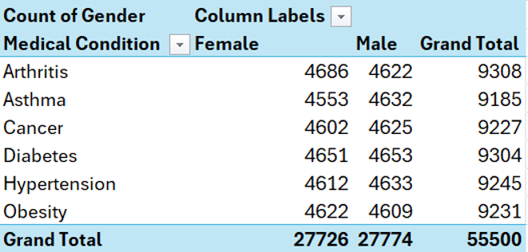
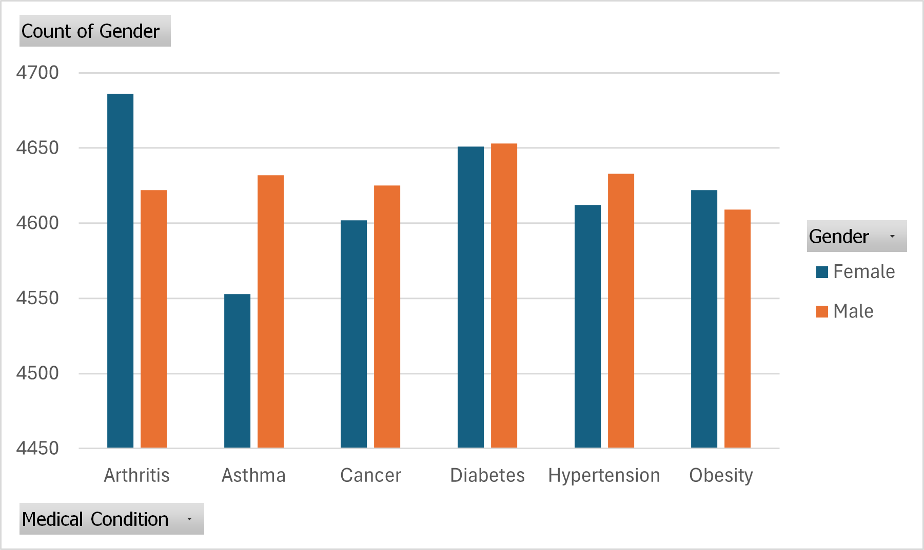
Medical Condition by Gender
According to the given data, Females are more likely to have Arthritis and Obesity.
Males are more likely to have Asthma, Cancer, and Hypertension.
While females are also more likely to have Diabetes than males, it’s so close that it’s not a drastic difference. So, in the case of Diabetes, both Males and Females are extremely likely to get Diabetes.

Slide 6
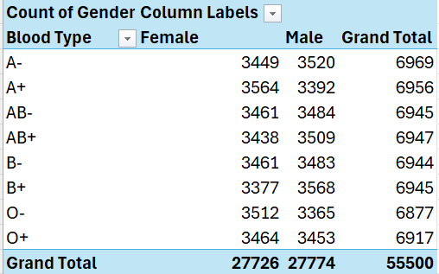
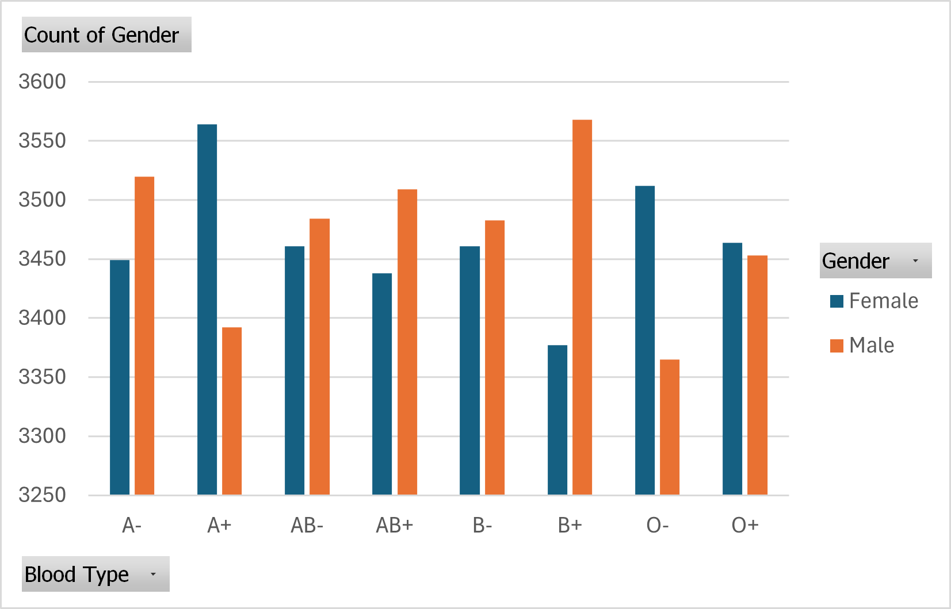
Blood Type by Gender
According to the given data, Males are more likely to have Blood Types of A+, O-, and O+.
Females are more likely to have A-, A+, AB-, AB+, B-, and B+.
AB negative is the rarest blood type, so according to the data, males would have a slightly higher chance to have AB negative blood than females.
Group O is the universal donor, and the group that’s more likely to have either O+ or O- are males.

Slide 7
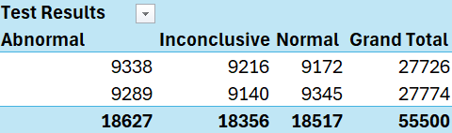
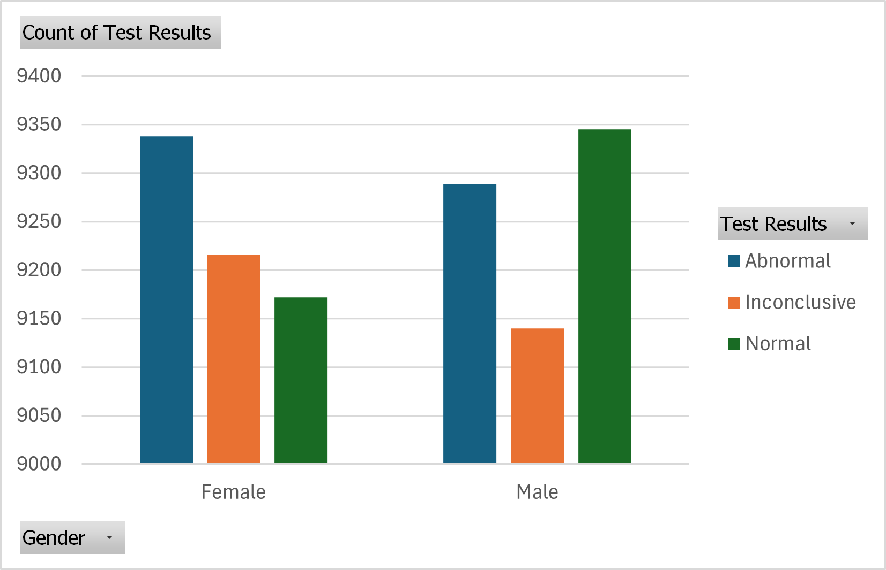
Test Results by Gender
According to the given chart and table, females are more likely to abnormal test results while males are likely to have normal test results.
There are many reasons why women could have abnormal test results. Some can include the following:
Women are more likely to report their symptoms than men
Genetics can play a factor as to why women have more abnormal test results.
Women to have more hormonal changes, which can be a factor for abnormal test results.

Slide 8
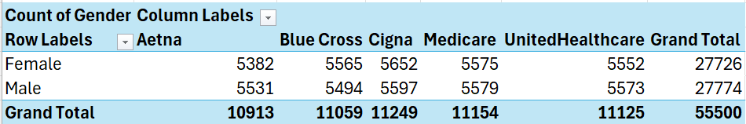
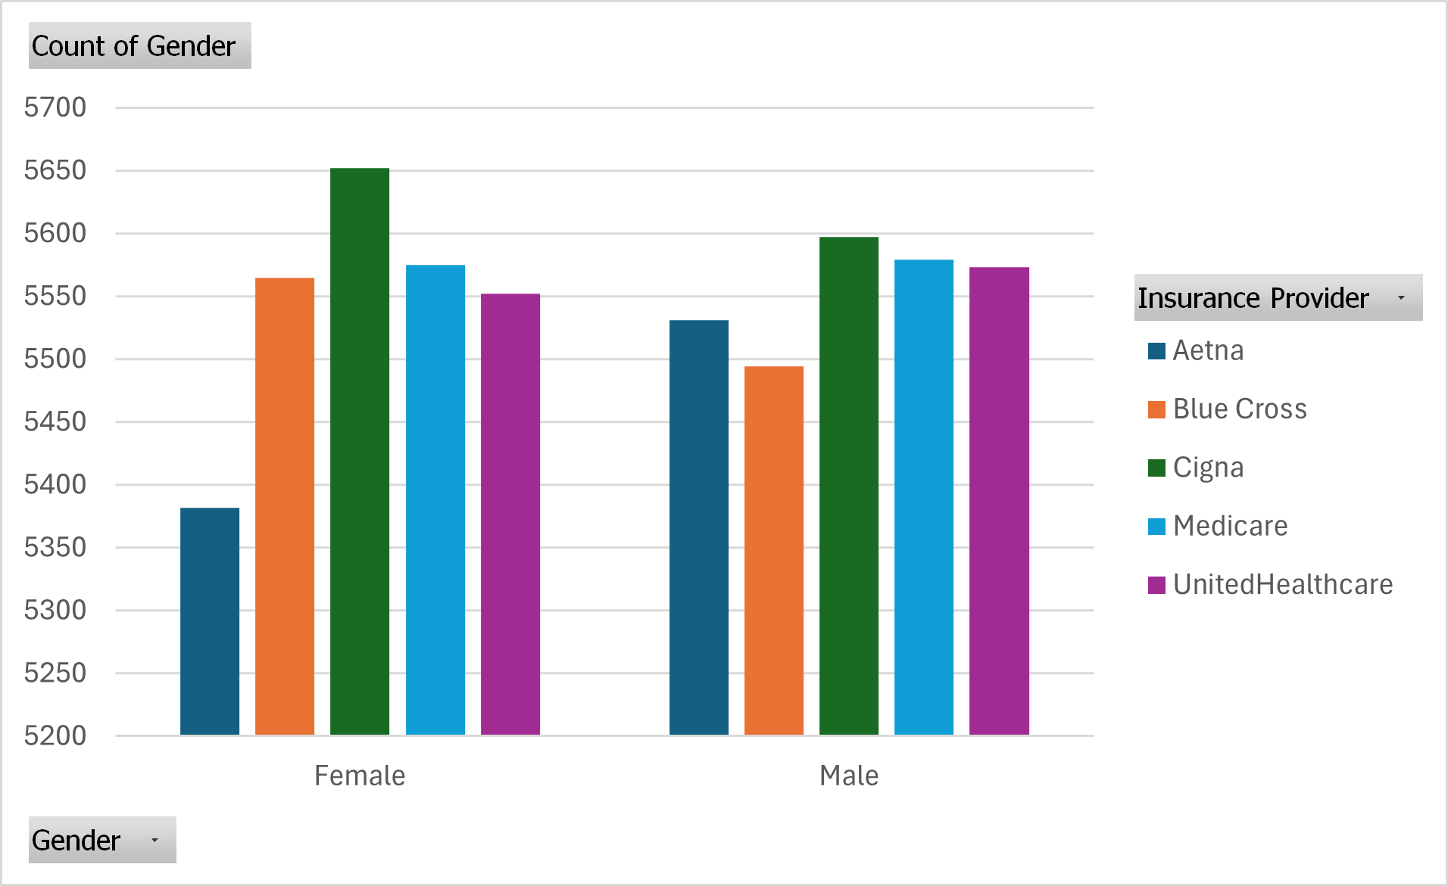
Insurance Provider by Gender
According to the given table and bar chart, Cigna is the most common insurance provider owned by both males and females. Following that was Medicare and UnitedHealthcare.
However, after that, we see that females are more likely to have Blue Cross as their insurance provider while males are more likely to have Aetna as their insurance provider.

Slide 9
Links Used
Blood Type:
Blood Types and Transfusion
Rare blood types
Test Results:
Gender Equality Index 2021: Health
Why Autoimmune Diseases Affect More Women Than Men
Dataset Used:
Healthcare Dataset

